Slide 1
AWS Lambda with Python

Slide 2
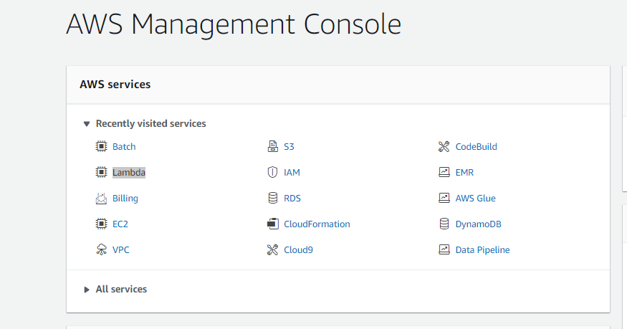
Go to AWS Console and Open Lambda

Slide 3
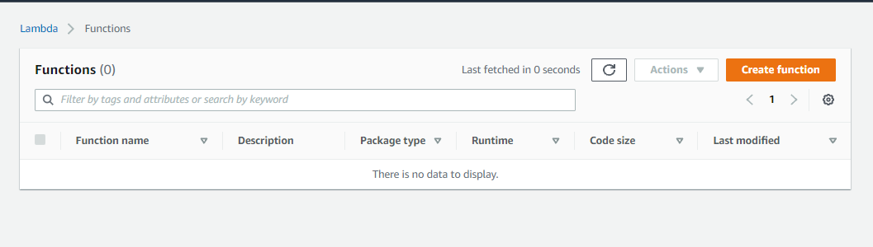
Create a function

Slide 4
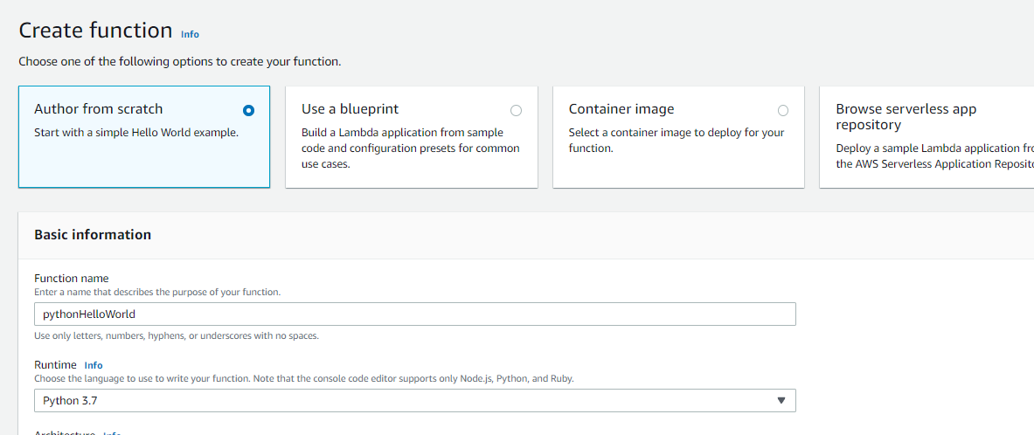
Name the function

Slide 5
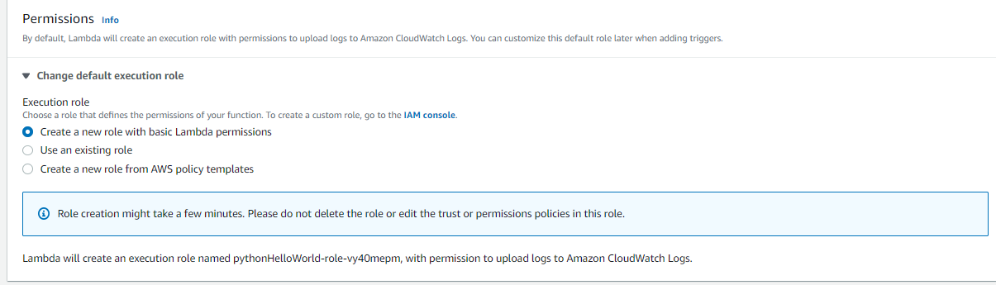

Slide 6
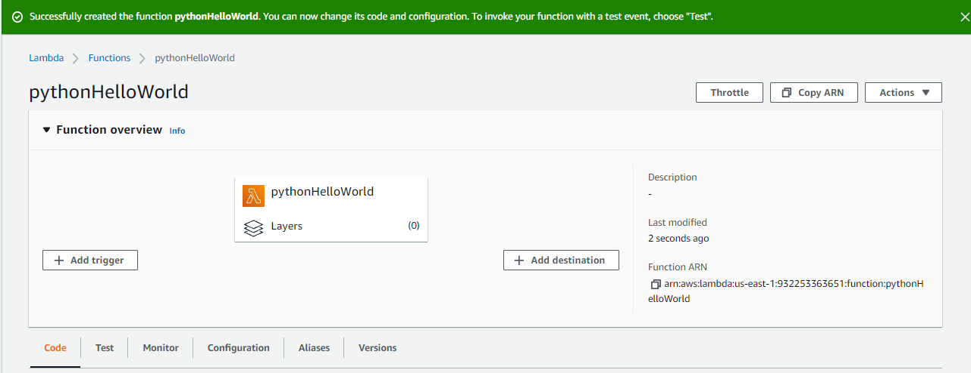
Function is Created

Slide 7
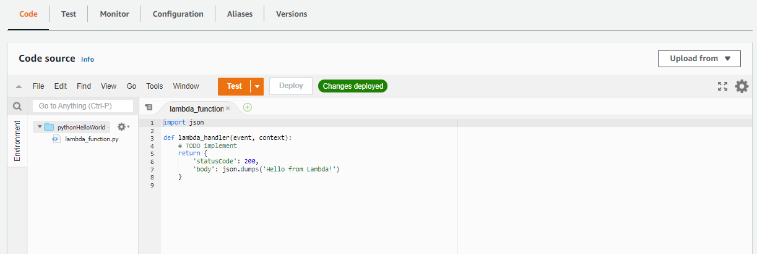
A python source code is present there, We can Test it

Slide 8
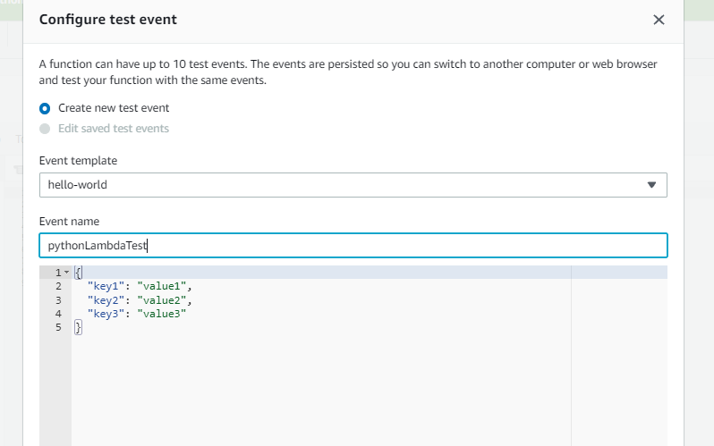
Create an Event name

Slide 9
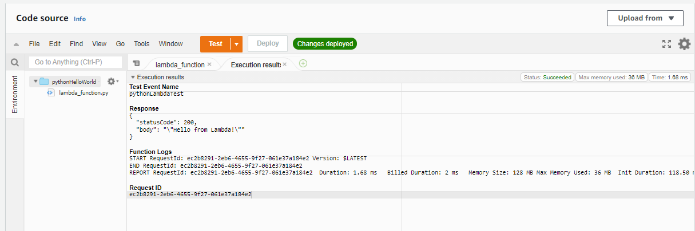
The Output is generated

